Slide 1
Clustering

Slide 2
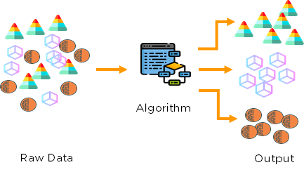
Unsupervised Machine Learning
No labels are given to the learning algorithm – leaving it on its own to find structures in the output.
Source: https://medium.com/analytics-vidhya/beginners-guide-to-unsupervised-learning-76a575c4e942

Slide 3
Unsupervised Machine Learning
Unsupervised learning is where you only have input data (X) and no corresponding output variables.
The goal for unsupervised learning is to model the underlying structure or distribution in the data in order to learn more about the data.
Algorithms are left to their own devises to discover and present the interesting structure in the data.
Further grouped into:
Clustering: A clustering problem is where you want to discover the inherent groupings in the data, such as grouping customers by purchasing behavior.
Association: An association rule learning problem is where you want to discover rules that describe large portions of your data, such as people that buy A also tend to buy B.

Slide 4
Semi-supervised Machine Learning
Problems where you have a large amount of input data (X) and only some of the data is labeled (Y ) are called semi-supervised learning problems.
These problems sit in between both supervised and unsupervised
A good example is a photo archive where only some of the images are labeled, (e.g. dog, cat, person) and the majority are unlabeled.
because it can be expensive or time consuming to label data as it may require access to domain experts.
Whereas unlabeled data is cheap and easy to collect and store.
You can use unsupervised learning techniques to discover and learn the structure in the input variables. You can also use supervised learning techniques to make best guess predictions for the unlabeled data, feed that data back into the supervised learning algorithm as training data and use the model to make predictions on new unseen data.

Slide 5
Unsupervised Machine Learning
Clustering
k-Means
Hierarchical Cluster Analysis (HCA)
Expectation Maximization
Visualization and dimensionality reduction
Principal Component Analysis (PCA)
Kernel PCA
Locally-Linear Embedding (LLE)
Association rule learning
Apriori

Slide 6
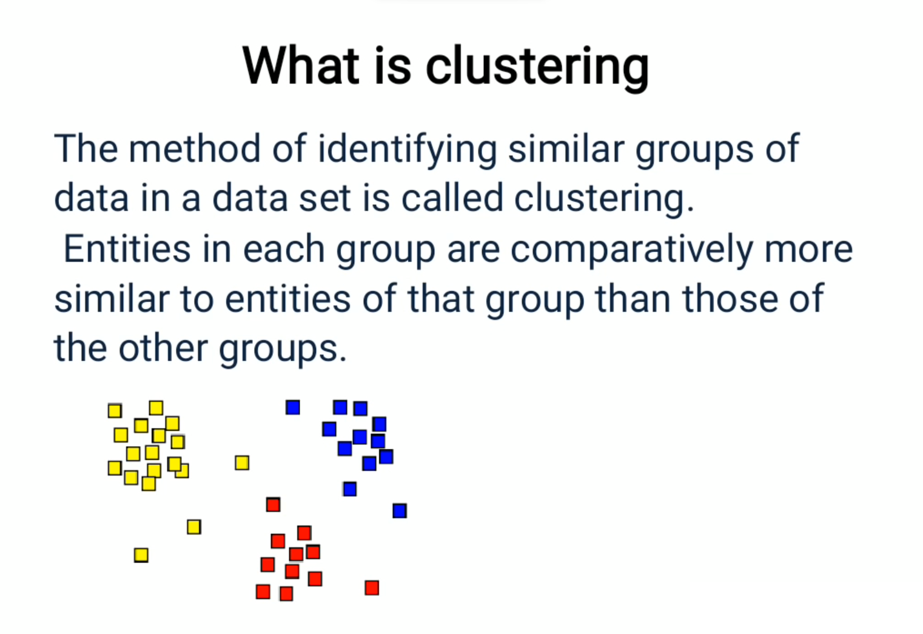

Slide 7
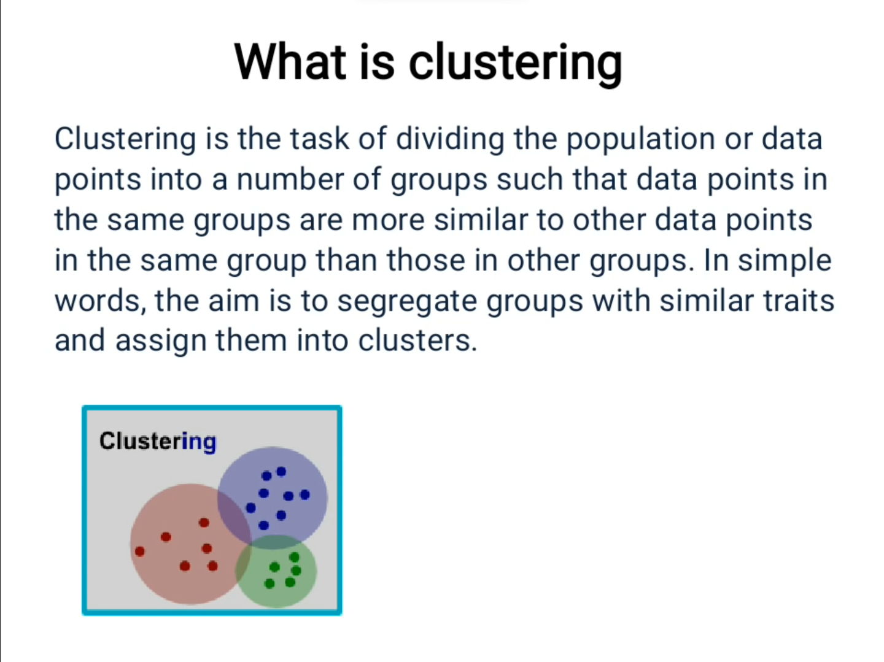

Slide 8
Clustering
Clustering is a machine learning technique for analyzing data and dividing in to groups of similar data.
These groups or sets of similar data are known as clusters.
Cluster analysis looks at clustering algorithms that can identify clusters automatically.
The goal of clustering is to discover both the dense and sparse regions in the data set.
Source: Benjamin Lam, Spring 2007, SJSU

Slide 9
Clustering
Clustering is known as unsupervised learning because the class label information is not present.
clustering is a form of learning by observation, rather than learning by examples.
Source: Data Mining Concepts and Techniques, by Jiawei Han Micheline Kamber, and Jian Pei

Slide 10
Clustering
Clustering can be considered the most important unsupervised learning technique; so, as every other problem of this kind, it deals with finding a structure in a collection of unlabeled data.
Clustering is “the process of organizing objects into groups whose members are similar in some way”.
A cluster is therefore a collection of objects which are “similar” between them and are “dissimilar” to the objects belonging to other clusters.
Source: Benjamin Lam, Spring 2007, SJSU

Slide 11



Clustering
Source: Benjamin Lam, Spring 2007, SJSU

Slide 12
Applications of Clustering
In business intelligence, clustering can be used to organize a large number of customers into groups, where customers within a group share strong similar characteristics.
This facilitates the development of business strategies for enhanced customer relationship management.
consider a consultant company with a large number of projects. To improve project management, clustering can be applied to partition projects into categories based on similarity so that project auditing and diagnosis (to improve project delivery and outcomes) can be conducted effectively.
Source: Data Mining Concepts and Techniques, by Jiawei Han Micheline Kamber, and Jian Pei

Slide 13
Applications of Clustering
Clustering is also called data segmentation in some applications because clustering partitions large data sets into groups according to their similarity.
Clustering can also be used for outlier detection, where outliers (values that are “far away” from any cluster) may be more interesting than common cases.
Example: detection of credit card fraud and the monitoring of criminal activities in electronic commerce. For example, exceptional cases in credit card transactions, such as very expensive and infrequent purchases, may be of interest as possible fraudulent activities.
Source: Data Mining Concepts and Techniques, by Jiawei Han Micheline Kamber, and Jian Pei

Slide 14
Applications of Clustering
Pattern recognition
Information retrieval
text mining
Web analysis
marketing
medical diagnostic
Source: Benjamin Lam, Spring 2007, SJSU

Slide 15
Types of Clustering:
Hard Clustering
Soft Clustering

Slide 16
Types of clustering algorithms:
Connectivity models
Centroid models
Distribution models
Density models

Slide 17
Which method should I use?
Type of attributes in data
Scalability to larger dataset
Ability to work with irregular or noisy data
Time cost
complexity
Data order dependency
Result presentation
Interpretability and usability
Source: Benjamin Lam, Spring 2007, SJSU

Slide 18
Pseudo Code of Clustering?
Pick an arbitrary number of groups/segments to be created
Start with some initial randomly chosen center values for groups
Classify instances to closest groups
Compute new values for the group centers
Repeat steps 3 and 4 till groups converge
If clusters are not satisfactory, go to step 1 and pick a different number of groups/segments
Source: Data Analytics by Anil Maheshwari

Slide 19
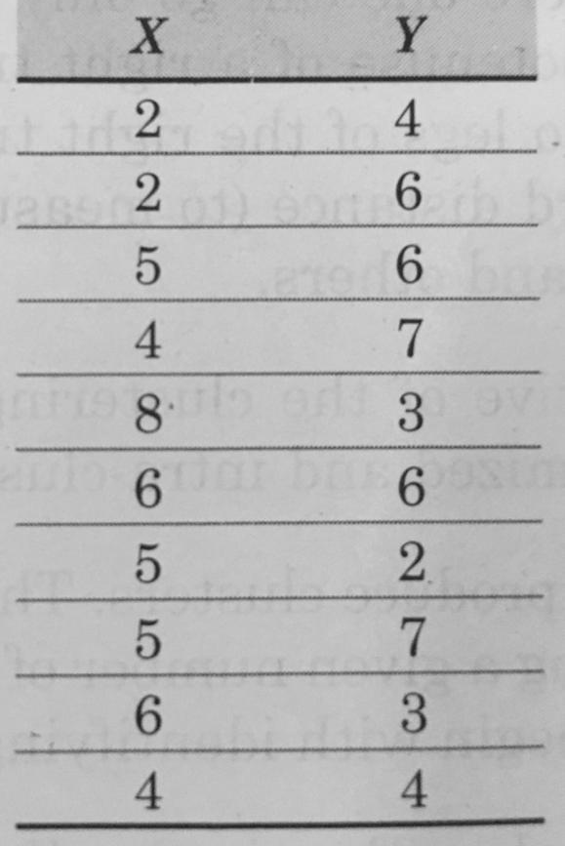
Example
Source: Data Analytics by Anil Maheshwari

Slide 20
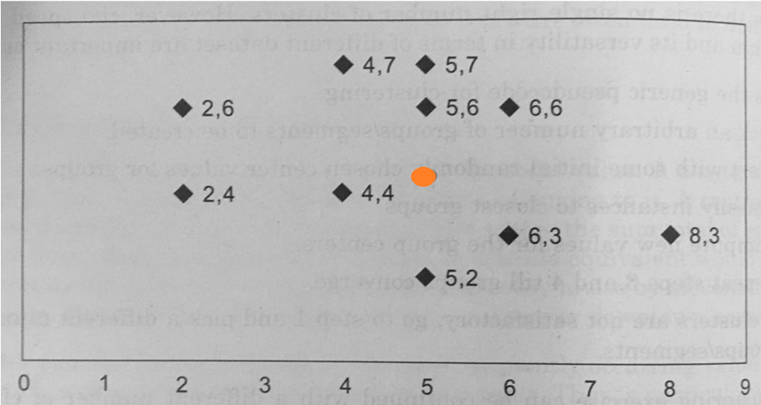
Example
Source: Data Analytics by Anil Maheshwari

Slide 21
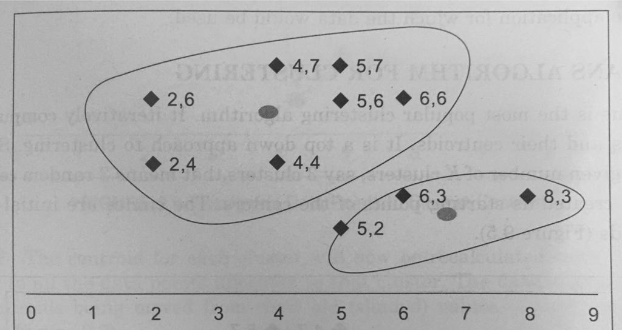
Example
Source: Data Analytics by Anil Maheshwari

Slide 22
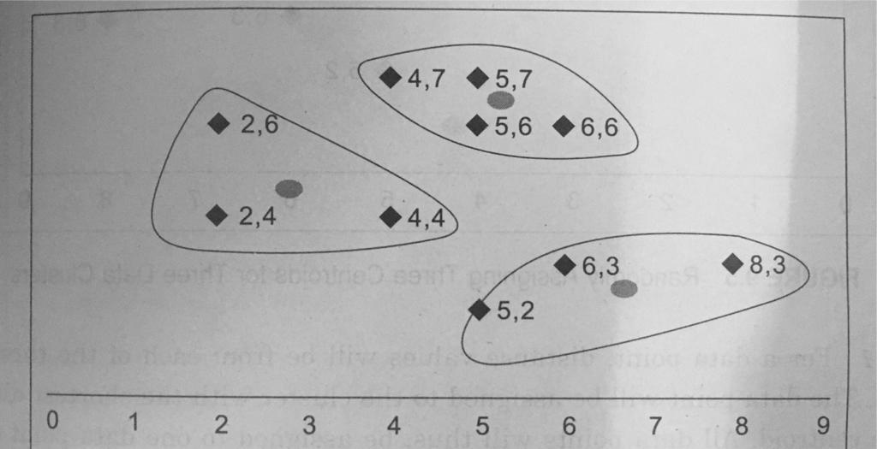
Example
Source: Data Analytics by Anil Maheshwari

Slide 23
Types of Clustering
A distinction among different types of clusterings is whether the set of clusters is nested or unnested.
Hierarchical Clustering
works by grouping data objects into a hierarchy or “tree” of clusters
Representing data objects in the form of a hierarchy is useful for data summarization and visualization
Ex: manager of human resources at AllElectronics you may organize your employees into major groups such as executives, managers, and staff
You can further partition these groups into smaller subgroups. For instance, the general group of staff can be further divided into subgroups of senior officers, officers, and trainees. All these groups forma hierarchy. We can easily summarize or characterize the data that are organized into a hierarchy, which can be used to find, say, the average salary of managers and of officers.
Source: Benjamin Lam, Spring 2007, SJSU

Slide 24
Types of Clustering
Partitioning Clustering
Partitioning algorithms divide the data set into mutually disjoint partitions or exclusive groups or clusters
Selection of number of clusters is the starting point for partitioning methods.
Formally, given a data set, D, of n objects, and k, the number of clusters to form, a partitioning algorithm organizes the objects into k partitions .k n/, where each partition represents a cluster
The clusters are formed on the basis of dissimilarity function based on distance, so that the objects within a cluster are “similar” to one another and “dissimilar” to objects in other clusters in terms of the data set attributes. Ex K-means
Source: Benjamin Lam, Spring 2007, SJSU

Slide 25
Types of Clustering
Density-based methods: Most partitioning methods cluster objects based on the distance between objects. Such methods can find only spherical-shaped clusters and encounter difficulty in discovering clusters of arbitrary shapes.
Other clustering methods have been developed based on the notion of density.
Idea is to continue growing a given cluster as long as the density (number of objects or data points) in the “neighborhood” exceeds some threshold.
For example, for each data point within a given cluster, the neighborhood of a given radius has to contain at least a minimum number of points.
Source: Benjamin Lam, Spring 2007, SJSU

Slide 26
Types of Clustering
Grid-based methods: Grid-based methods quantize the object space into a finite number of cells that form a grid structure.
All the clustering operations are performed on the grid structure (i.e., on the quantized space).
The main advantage of this approach is its fast processing time, which is typically independent of the number of data objects and dependent only on the number of cells in each dimension in the quantized space.
Source: Benjamin Lam, Spring 2007, SJSU

Slide 27
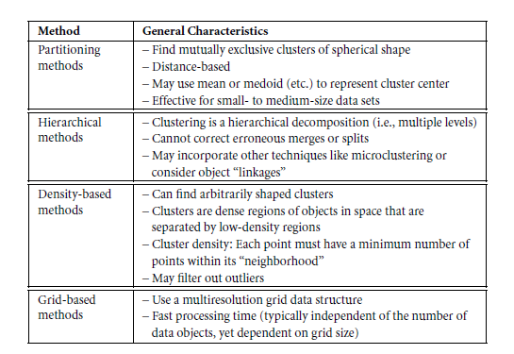

Slide 28
Hierarchical Clustering
Hierarchical clustering algorithms repeat the cycle of either merging smaller clusters in to larger ones or dividing larger clusters to smaller ones
Creates hierarchical decomposition of the database
Decomposition of clusters is represented by a dendrogram
Two types of Hierarchical clustering
Agglomerative
Divisive
In either agglomerative or divisive hierarchical clustering, a user can specify the desired number of clusters as a termination condition.
Source: Benjamin Lam, Spring 2007, SJSU

Slide 29
Hierarchical Clustering
Agglomerative clustering
bottom-up approach of merging clusters in to larger ones,
divisive clustering
top-down approach of splitting clusters in to smaller ones
Typically, the greedy approach is used in deciding which larger/smaller clusters are used for merging/dividing
Euclidean distance, Manhattan distance and cosine similarity are some of the most commonly used metrics of similarity for numeric data
For non-numeric data, metrics such as the Hamming distance is used
Source: Benjamin Lam, Spring 2007, SJSU

Slide 30
Hierarchical Clustering
AGNES (AGglomerative NESting),
Step 1: Create a cluster for each data object i.e. Creation of n clusters for n objects
Step 2: merge two closest clusters i.e. n-1 clusters
Step 3: repeat step 2 untill there is only one cluster
Source: Data Mining Concepts and Techniques, by Jiawei Han Micheline Kamber, and Jian Pei

Slide 31
Hierarchical Clustering
AGNES (AGglomerative NESting),
Ex. a data set of five objects, a,b, c,d, e.
Initially, AGNES, the agglomerative method, places each object into a cluster of its own.
The clusters are then merged step-by-step according to some criterion clusters C1 and C2 may be merged if an object in C1 and an object in C2 form the minimum Euclidean distance between any two objects from different clusters
E.D. between two points = sqrt((x₂-x₁)² +(y₂-y₁)²)
Source: Data Mining Concepts and Techniques, by Jiawei Han Micheline Kamber, and Jian Pei

Slide 32
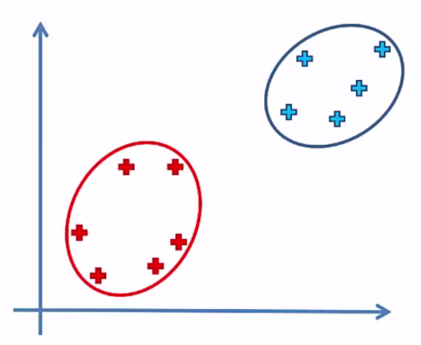
Hierarchical Clustering
Distance between two clusters (linkage measures) :
Closest points - Farthest points
Average distance - Distance between centroids
Source: Data Mining Concepts and Techniques, by Jiawei Han Micheline Kamber, and Jian Pei

Slide 33
Hierarchical Clustering
DIANA (DIvisive ANAlysis), the divisive method, proceeds in the contrasting way. All the objects are used to form one initial cluster.
The cluster is split according to some principle such as the maximum Euclidean distance between the closest neighboring objects in the cluster
A challenge with divisive methods is how to partition a large cluster into several smaller ones.
When n is large, it is computationally prohibitive to examine all possibilities.
Consequently, a divisive method typically uses heuristics in partitioning, which can lead to inaccurate results
Source: Data Mining Concepts and Techniques, by Jiawei Han Micheline Kamber, and Jian Pei

Slide 34
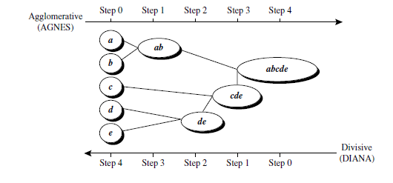
Hierarchical Clustering
Source: Data Mining Concepts and Techniques, by Jiawei Han Micheline Kamber, and Jian Pei

Slide 35
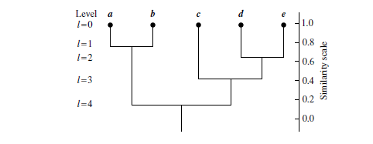
Hierarchical Clustering
tree structure called a dendrogram is commonly used to represent the process of hierarchical clustering.
It shows how objects are grouped together (in an agglomerative method) or partitioned (in a divisive method) step-by-step.
Source: Data Mining Concepts and Techniques, by Jiawei Han Micheline Kamber, and Jian Pei

Slide 36
Hierarchical Clustering
Source: Data Mining Concepts and Techniques, by Jiawei Han Micheline Kamber, and Jian Pei

Slide 37
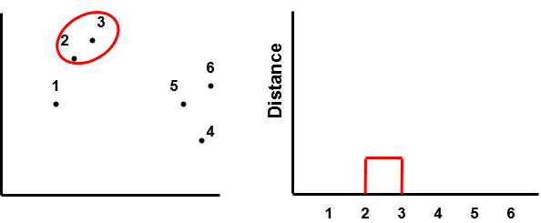
Dendrogram

Slide 38
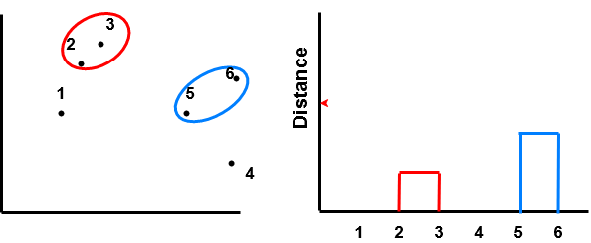
Dendrogram

Slide 39
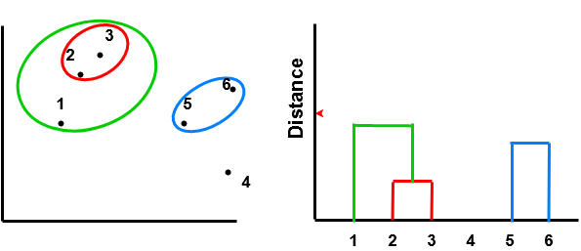
Dendrogram

Slide 40
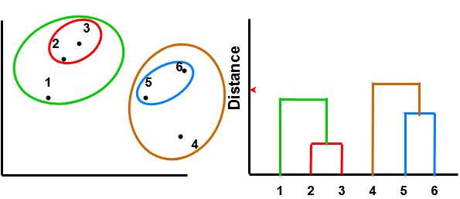
Dendrogram

Slide 41
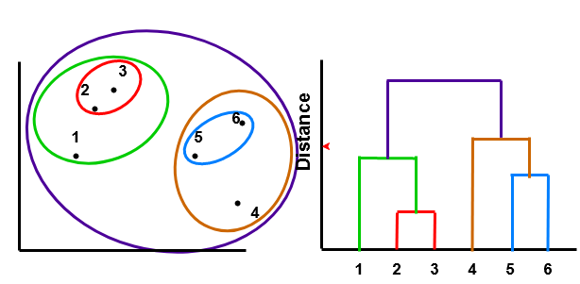
Dendrogram

Slide 42
Partitioning clustering
generate various partitions and then evaluate them by some criterion
also referred to as nonhierarchical as each instance is placed in exactly one of k mutually exclusive clusters
Because only one set of clusters is the output of a typical partitioning clustering algorithm, the user is required to input the desired number of clusters (usually called k)
most commonly used partitioning clustering algorithms is the k-means clustering algorithm
User is required to provide the number of clusters (k) before starting
Source: Benjamin Lam, Spring 2007, SJSU

Slide 43
Partitioning clustering
User is required to provide the number of clusters (k) before starting and the algorithm first initiates the centers (or centroids) of the k partitions
In a nutshell, k-means clustering algorithm then assigns members based on the current centers and re-estimates centers based on the current members
These two steps are repeated until a certain intra-cluster similarity objective function and inter-cluster dissimilarity objective function are optimized
Therefore, sensible initialization of centers is a very important factor in obtaining quality results from partitional clustering algorithms
Source: Benjamin Lam, Spring 2007, SJSU

Slide 44
Difference between Hierarchical and Partitioning Clustering?
key differences in running time, assumptions, input parameters and resultant clusters.
Typically, partitioning clustering is faster than hierarchical clustering
Hierarchical clustering requires only a similarity measure, while partitioning clustering requires stronger assumptions such as number of clusters and the initial centers
Hierarchical clustering does not require any input parameters, while partitional clustering algorithms require the number of clusters to start running
Hierarchical clustering returns a much more meaningful and subjective division of clusters but partitional clustering results in exactly k clusters.
Source: Benjamin Lam, Spring 2007, SJSU

Slide 45
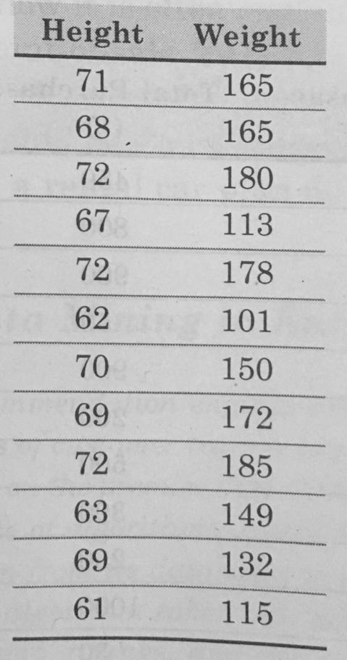
Exercise
Data about height and weight of few customers is available. Create a set of clusters for the available data to decide how many sizes of T-Shirt should be ordered.

Slide 46
K-Means Clustering
Simplest and most commonly used method
Is a geometrical model
Tries to find cluster centers that are representative of certain regions of the data
The k-means clustering algorithm alternates between two steps:
assigning each data point to its closest cluster center
setting each cluster center as the mean of the data points that are assigned to it
The algorithm finishes when the assignment of instances to clusters no longer changes

Slide 47
K-Means Clustering
Choose the number of clusters (x)
Select the centroids (random) equal to number of clusters (x)
Assign each data point to its closest centroid, this will create x clusters
Compute the new centroid of each cluster based on the data points within the cluster
Reassign each data point to the new centroid, if reassignment occurs then go to previous step, otherwise quit the algorithm

Slide 48
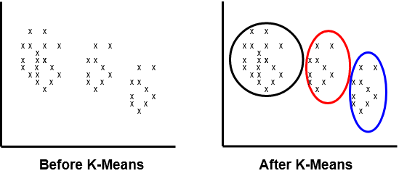
K-Means Clustering

Slide 49
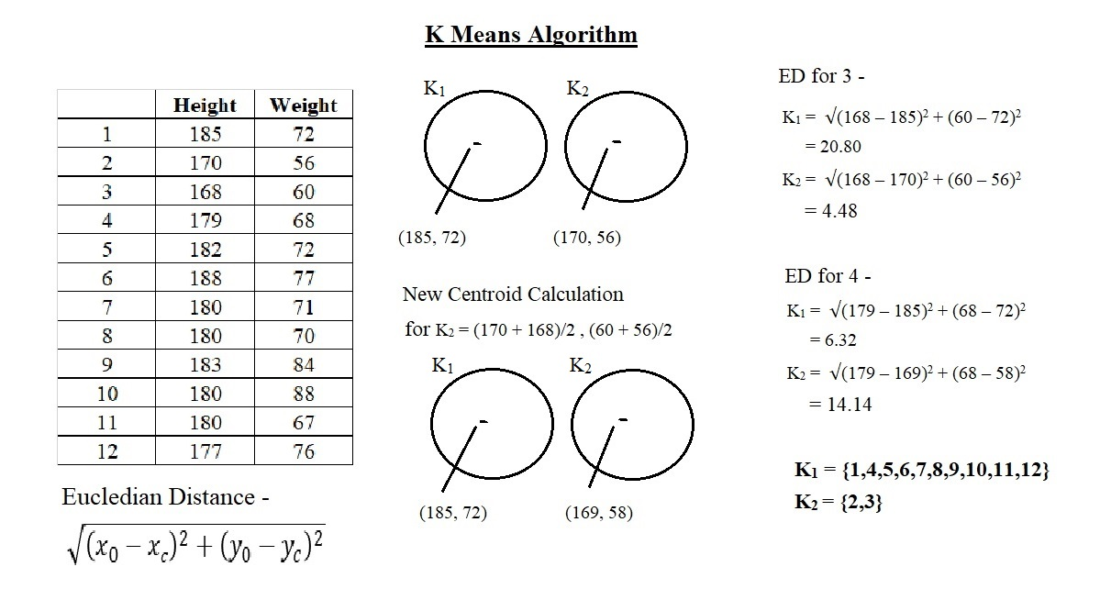

Slide 50
K-Modes Clustering
K-Means is one of the most common used method of clustering but not perform well on the categorical data or features
For example categorical input variables such as “designation of the employee” or “branch of a student”
It creates clusters based on the number of matching categories (while K-Means works on the basis of some distance measures such as “Euclidean Distance” between the data points)
K-Modes attempts to minimize a dissimilarity measure

Slide 51
K-Modes Clustering
The changes to the k-Means clustering are –
using a simple matching dissimilarity measure for categorical objects,
replacing means of clusters by modes, and
using a frequency-based method to update the modes.
Let X, x11, x12,…,xnm be the data set consists of n number of objects with m number of attributes. The main objective of the kmodes clustering algorithm is to group the data objects X into K clusters by minimize the cost function

Slide 52
K-Modes Clustering
Input: Data objects X, Number of clusters K.
Step 1: Randomly select the K initial modes from the data objects such that Cj, j = 1,2,…,K
Step 2: Find the matching dissimilarity between the each K initial cluster modes and each data objects
Step 3: Evaluate the fitness
Step 4: Find the minimum mode values in each data object i.e. finding the objects nearest to the initial cluster modes.
Step 5: Assign the data objects to the nearest cluster centroid modes.
Step 6: Update the modes by apply the frequency-based method on newly formed clusters.
Step 7: Recalculate the similarity between the data objects and the updated modes.
Step 8: Repeat the step 4 and step 5 until no changes in the cluster ship of data objects.
Output: Clustered data objects

Slide 53
K-Modes Clustering
import numpy as np
from kmodes.kmodes import KModes
# random categorical data
data = np.random.choice(20, (100, 10))
print(data)
km = KModes(n_clusters=4, init='Huang', n_init=5, verbose=1)
clusters = km.fit_predict(data)
# Print the cluster centroids
print(km.cluster_centroids_)

Slide 54
Gaussian Mixture Models (GMMs)
distribution-based model
Gaussian Mixture Models (GMMs) assume that there are a certain number of Gaussian distributions, and each of these distributions represent a cluster. Hence, a Gaussian Mixture Model tends to group the data points belonging to a single distribution together.
Gaussian Mixture Models are probabilistic models and use the soft clustering approach for distributing the points in different clusters

Slide 55
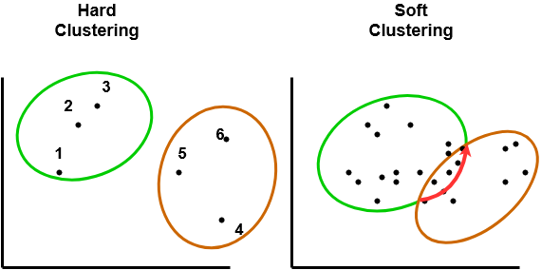
Hard vs Soft Clustering

Slide 56
𝐾-Means vs GMM
𝐾-means algorithm performs a hard assignment of data points to clusters, in which each data point is associated uniquely with one cluster,
GMM algorithm makes a soft assignment based on posterior probabilities based on EM Algorithm.
𝐾-means is only based on Euclidean distances,
classic GMM use a Mahalanobis distances that can deal with non-spherical distributions
The Mahalanobis distance is unitless and scale-invariant, and takes into account the correlations of the data set.

Slide 57
Gaussian Mixture Models (GMMs)
Example: three Gaussian distributions– GD1, GD2, and GD3.
have a certain mean (μ1, μ2, μ3) and
variance (σ1, σ2, σ3) value respectively.
For a given set of data points, our GMM would identify the probability of each data point belonging to each of these distributions.

Slide 58
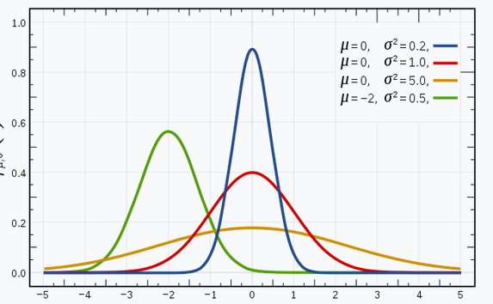
Gaussian Mixture Models (GMMs)
Image Source: WikiPedia

Slide 59
Expectation-Maximization Algorithm
Expectation-Maximization (EM) is a statistical algorithm for finding the right model parameters. We typically use EM when the data has missing values or Latent Variables, or in other words, when the data is incomplete.
It’s difficult to determine the right model parameters due to these missing variables.
Expectation-Maximization tries to use the existing data to determine the optimum values for these latent variables and then finds the model parameters.
Based on these model parameters, we go back and update the values for the latent variable, and so on.
E-step: In this step, the available data is used to estimate (guess) the values of the missing variables
M-step: Based on the estimated values generated in the E-step, the complete data is used to update the parameters

Slide 60
Expectation-Maximization Algorithm
Initialize parameters randomly
while not converged
E-Step: Create one training example for each possible value of the latent variables Weight each example according to model’s confidence
M-Step: Set the parameters to the values that maximizes likelihood

Slide 61
Expectation-Maximization Algorithm
Example: Assume k number of clusters.
This means that there are k Gaussian distributions, with the mean and covariance values to be μ₁, μ_{2, .. μk} and Σ₁, Σ₂, .. Σk .
Additionally, there is another parameter for the distribution that defines the number of points for the distribution. Or in other words, the density of the distribution is represented with Π_{i}.
Now, we need to find the values for these parameters to define the Gaussian distributions. We already decided the number of clusters, and randomly assigned the values for the mean, covariance, and density.
Next, we’ll perform the E-step and the M-step!

Slide 62
Expectation-Maximization Algorithm
E-Step
For each point x_{i}, calculate the probability that it belongs to cluster/distribution c₁, c₂, … c_{k}. This is done using the below formula:
Probability x_{i} belongs to c/ sum of probability of x_{i} belongs to c₁, c₂, … c_{k}
This value will be high when the point is assigned to the right cluster and lower otherwise.

Slide 63
Expectation-Maximization Algorithm
M-Step
update the Π, μ and Σ values.
The new density Π is defined by the ratio of the number of points in the cluster and the total number of points:
The mean and the covariance matrix are updated based on the values assigned to the distribution, in proportion with the probability values for the data point. Hence, a data point that has a higher probability of being a part of that distribution will contribute a larger portion

Slide 64
Expectation-Maximization Algorithm
Based on the updated values generated from this step, we calculate the new probabilities for each data point and update the values iteratively. This process is repeated in order to maximize the log-likelihood function.
Hence, k-means only considers the mean to update the centroid while GMM takes into account the mean as well as the variance of the data!

